Slide 1
Leadership Orange: Guiding Students Through Their Academic Career
January 19, 2024
Mary Bridges, Executive Director, Student Services

Slide 9
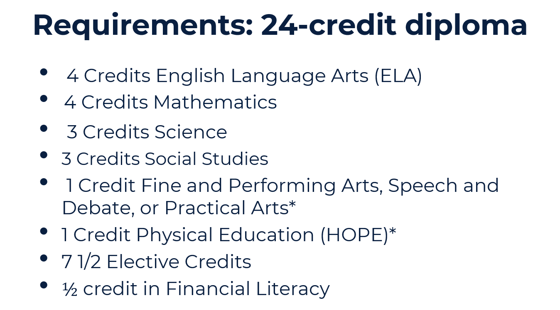

Slide 22
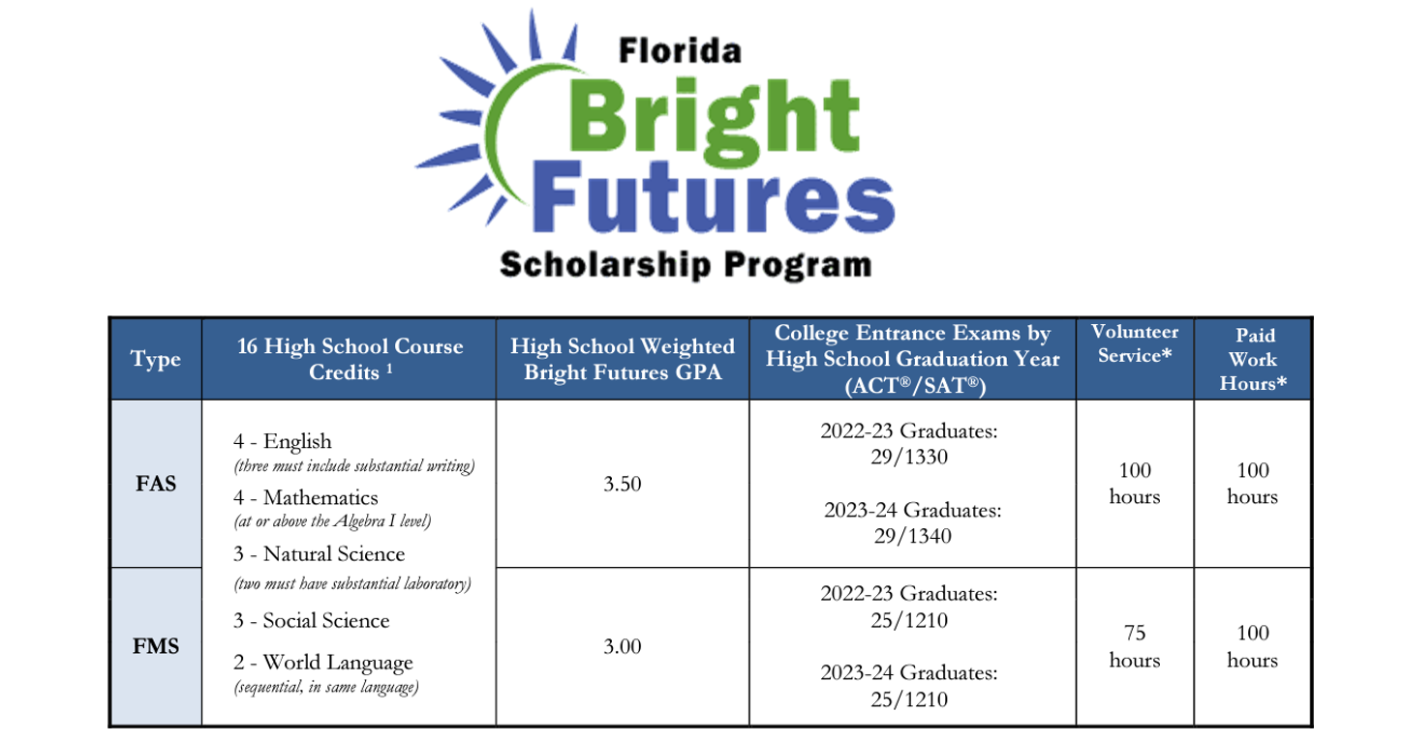

Slide 23
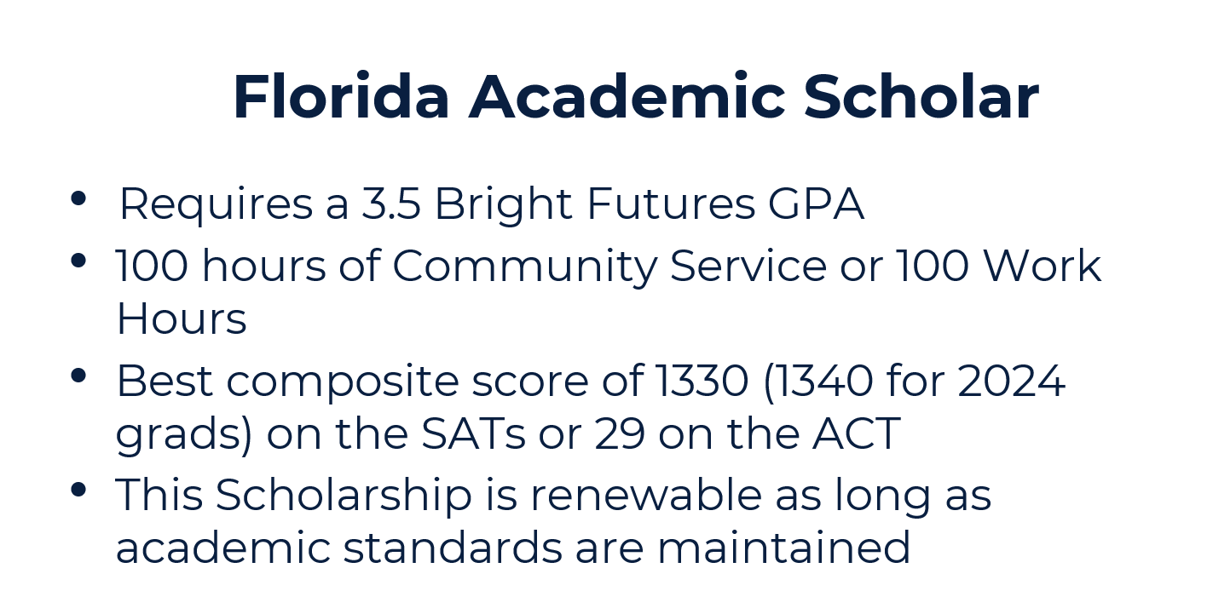

Slide 24
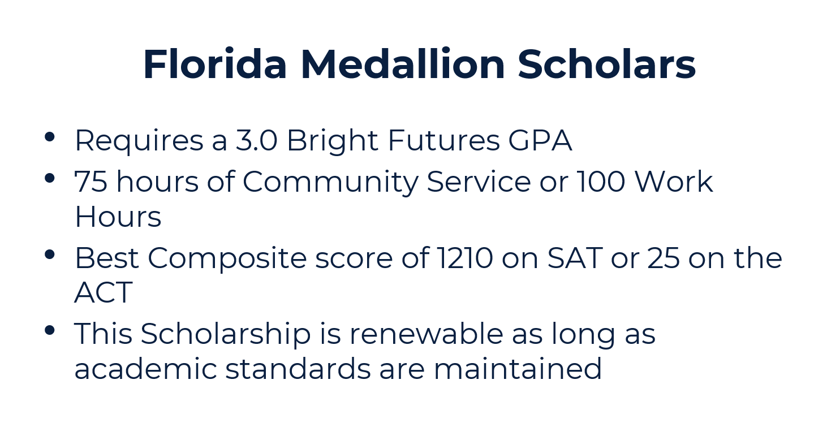

Slide 27
Questions?

